Slide 1
Convolution
Coding
CT - 216 PROJECT
Prof. Yash Vasavada
Lab Group 3
Project Group 14
Mentor : Bibin Baby John

Slide 2









Honor Code:
We declare that:
The work that we are presenting is our own work.
We have not copied the work (the code, the results etc.) that someone else has done.
Concepts, understanding and insights we will be describing are our own.
We make this pledge truthfully. We know that violation of this solemn pledge can carry grave consequences.

Slide 3
Introduction:
Convolution coding is a widely used method to correct errors and make communication more reliable.
Unlike block coding based on blocks of bits , in convolution coding output bits are determined by logic operations on present bit stream and a small no of previous bits .
We prefer convolution codes over LDPC and Polar codes when the block lengths are very short, convolution coding don’t require you to collect large block of bits before encoding, Polar and LDPC codes both shine at large block lengths (thousands of bits),but at short blocks (≲200 bits) their performance falls off, whereas convolutional + Viterbi decoding still gives good gain with predictable complexity.
They are also preferred when you work with real-time bit stream and it is also easier to build in hardware. Because of these advantages, we prefer convolution coding over other types of error-correcting codes.

Slide 4
Flow Diagram:
Input Data Bits
Convolution Encoder
BPSK Modulator
AWGN Channel
Output Bits
Decoder
BPSK
Demodulator

Slide 5
Convolution Encoder:
A convolutional encoder is defined by three parameters: K, k, and n:
k: number of input bits at a time step.
n: number of output bits for each input k-bit block.
K: constraint length, which determines size of the memory block
The encoder processes input bits using shift registers and outputs n bits for every k input bits
Rate : k / n

Slide 6
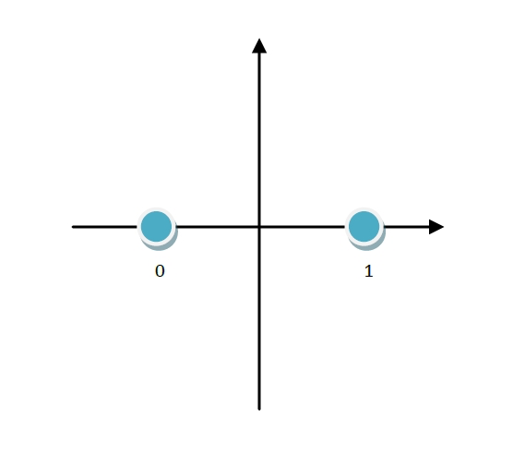
BPSK Modulator:
Binary Phase Shift Keying (BPSK) is a method used in communication systems to send information.
It works by changing the phase of a signal to represent binary data (0s and 1s).
Basically, it turns the binary data into signal changes (called symbols), making digital communication easier.
-1
1
1

Slide 7
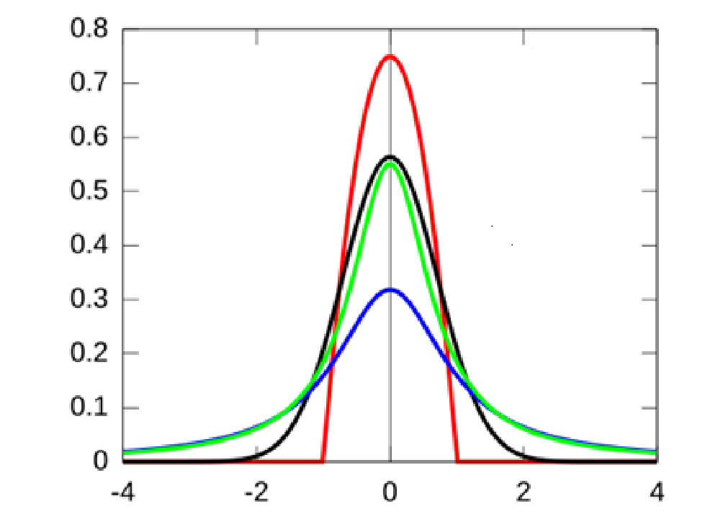
AWGN Channel:
Additive White Gaussian Noise (AWGN) , term “additive” means that the noise is simply added to the signal, while “white” indicates that the noise has equal power across all frequencies. The term “Gaussian” suggests that the noise has a normal distribution in amplitude, which is also known as a bell curve.
When a modulated encoded signal passes through a channel with AWGN, the noise can distort or change the signal, making it harder to receive the original message correctly.

Slide 8
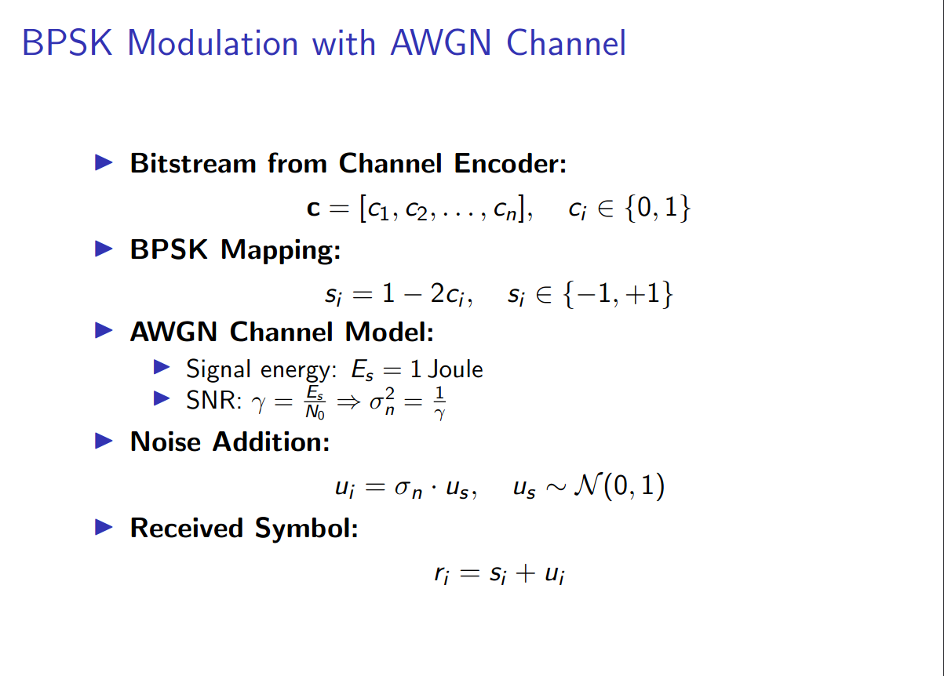

Slide 9
BPSK Demodulator:
The demodulator job is to recover the original binary data from this modulated carrier.
Decision Making: The resulting signal is sampled and its sign is checked:
If r >= 0 → binary 0
If r < 0 → binary 1
Where r is received signal.

Slide 10
Trellis Representation:
Convolutional codes are often shown using a trellis diagram.
In this diagram:
Each point (node) shows a possible state of the encoder.
The lines (edges) between points show how the encoder can move from one state to another when sending bits.
This diagram helps us easily see all the possible paths the encoder can take while sending data.

Slide 11
Viterbi Decoder:
The Viterbi decoding algorithm helps figure out what was originally sent by using:
Branch Metric (BM)
Path Metric (PM)
The branch metric checks how different the received bits are from the expected bits.
If we use hard decision decoding (just 0s and 1s), we use Hamming distance to count how many bits are different.
If we use soft decision decoding (with real-valued inputs, not just 0s and 1s), we use Euclidean distance, which gives a more accurate measurement.

Slide 12
Computing Path and Branch metric:
Computing Branch and Path metric is crucial for decoding using algorithms like viterbi algorithm.
Branch metric :
A Branch metric is cost of transitioning from one state to another , based on received symbol and expected output .
It is typically computed using Hamming Distance(for hard decisions) and Euclidean Distance(for soft decisions)
Path metric :
A path metric is cumulative cost (sum of branch metrics ) along a path through the trellis

Slide 13
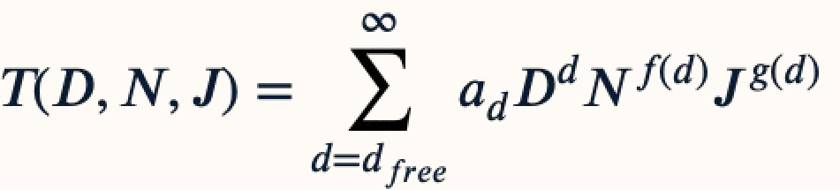
Transfer Function:
﻿﻿Paths start from all zero state, traverse a Trellis path and return to all zero state for the first time
﻿﻿Multiple Trellis paths (2^{k}) exist that start and end in all zero states having the same code word lengths (visual information in Trellis diagram)
﻿﻿Transfer function: An algebraic representation of all the paths that start and end at all zero state.
D - exponent ‘d’ indicates the number of ones in output code word
N - exponent ‘f(d)’ indicates the number of ones in input block k -bits at a time
J- exponent ‘g(d)’ indicates the number of branches spanned by the path
dfree is the minimum Hamming distance between any two distinct valid code sequences in a convolutional code.

Slide 14
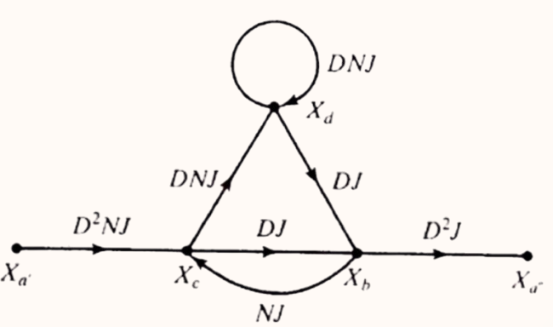
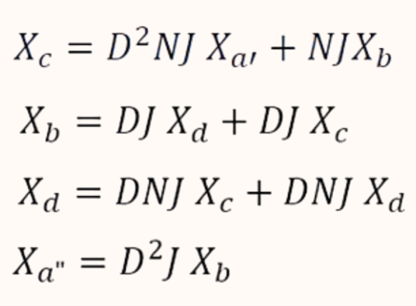
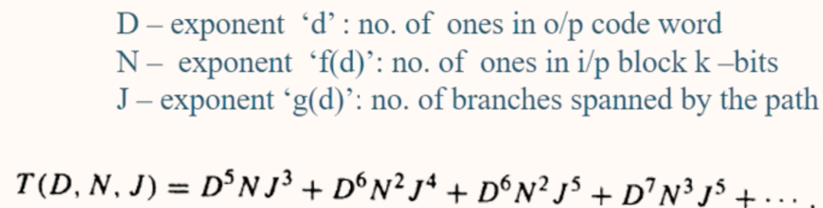

Slide 15
State Diagram:
0/00
00
0/11
1/11
A
01
0/01
10
B
C
1/00
0/10
1/10
11
D
1/01

Slide 16
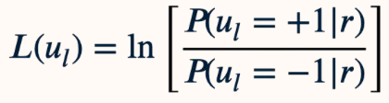
BCJR Algorithm:
BCJR algorithm computes the a-posteriori L-Values of each information bit.
Where Σ_{l}⁺ is the set of all state pairs s_{l} = s’ and s_{l+1} = s that correspond to the input bit u_{l} = +1 at time l.

Slide 17
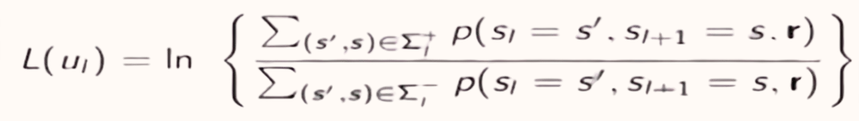
A
0/01
A
Eg.
(s’, s) => (A,B) , (B,B)
0/11
1/10
B
B
1/00
(Equation 1)
The joint pdf’s p(s’,s,r) in Equation 1 can be evaluated recursively:
p(s’,s,r) = p(s’ , s, r_{t<l} , r_{l} , r_{t>l} )
= p(r_{t>l} | s’ , s, r_{t<l} , r_{l} ) p(s’ , s, r_{t<l} , r_{l} )
= p(r_{t>l} | s’ , s, r_{t<l} , r_{l} ) p(s,r_{l} | s’ , r_{t<l} ) p(s’ , r_{t<l} )
= p(r_{t>l} | s) p(s, r_{l} | s’) p(s’, r_{t<l}) (Equation 2)

Slide 18
Where r_{t<l} represents the portion of the received sequence r before time l and r_{t>l} , represents the portion of the received sequence r after time l.
α_{l}(s') ≡ p(s', r_{t<l} )
β_{l+1}(s) ≡ p(r_{t>l}| s)
γ_{ι}(s', s) = p(s, r_{l}| s')
Equation 2 can be written as
𝑝(𝑠′, 𝑠 , 𝑟)= 𝛽_{𝑙+1}(𝑠) 𝛾_{𝑙}(𝑠′,𝑠)𝛼_{𝑙}(𝑠′)

Slide 19
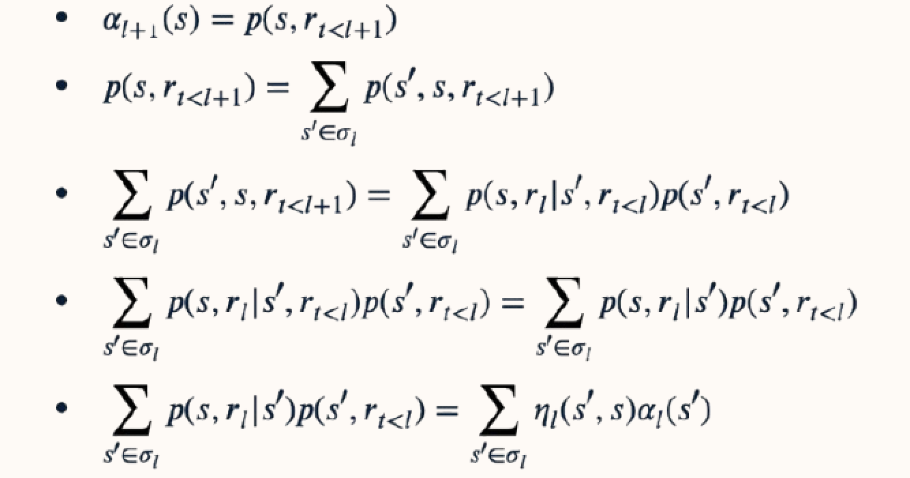
Where σ_{l} is the set of all states at time.

Slide 20
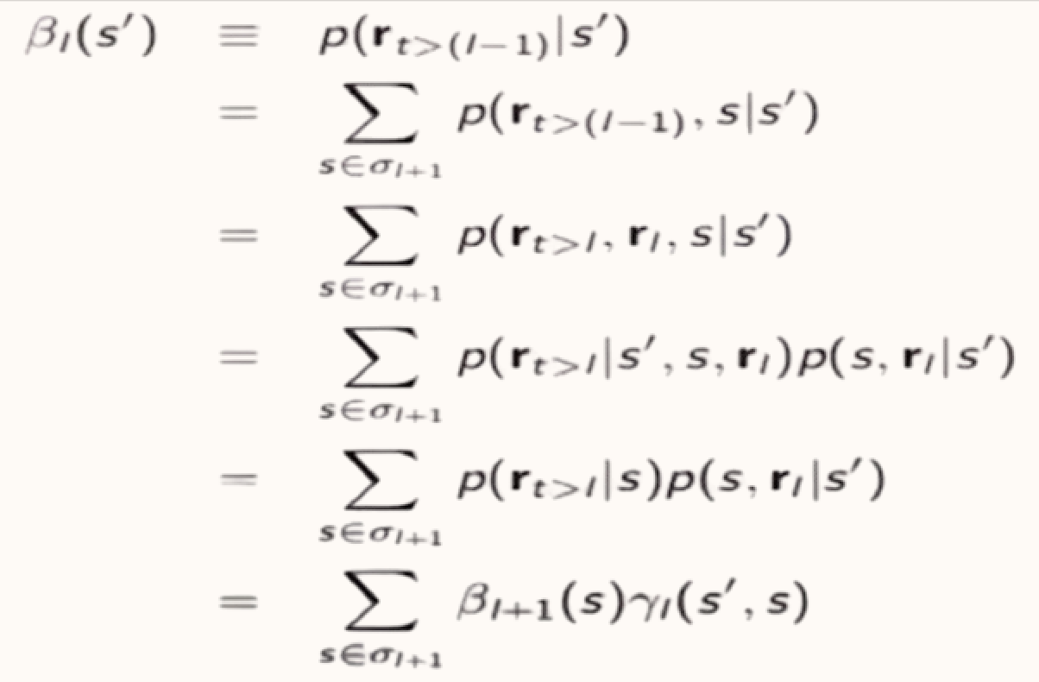
A
0/01
A
α_{l}₊₁(A) = γₗ (A , A) αₗ ( A ) + γₗ (B , A) αₗ (B)
α_{l}₊₁(B) = γₗ (B , B) αₗ ( B ) + γₗ (A , B) αₗ (A)
1/11
1/10
B
B
0/00

Slide 21
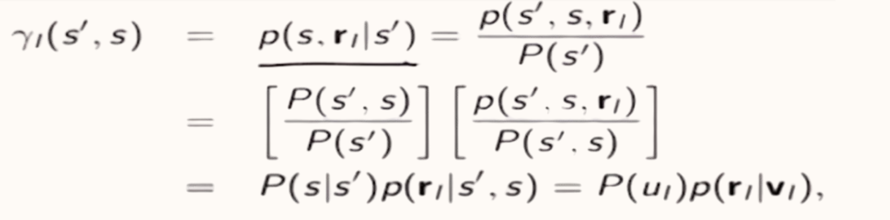

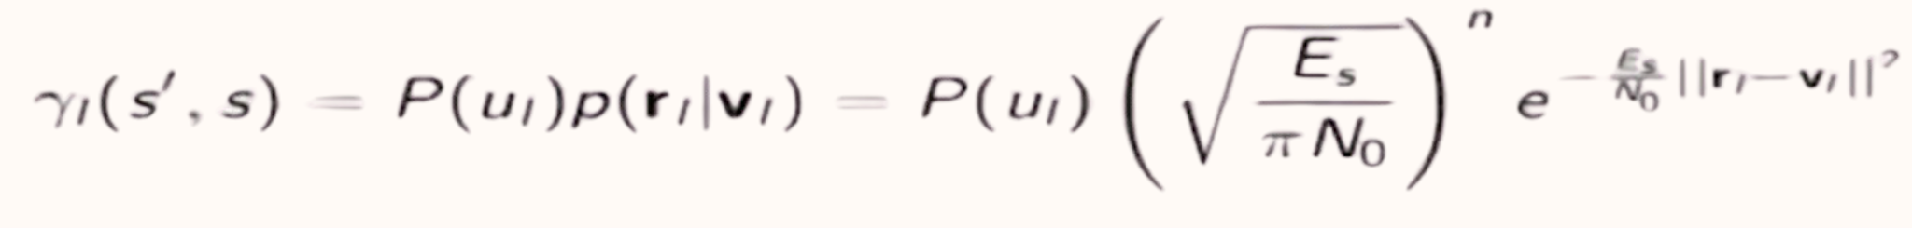
Where u_{l} is the input and v_{l} is the output bits corresponding to the state transition s’ -> s at time l.
Where || r_{l} - v_{l}||² is the squared Euclidean distance between the received branch r_{l} and the transmitted branch v_{l} at time l.

Slide 22
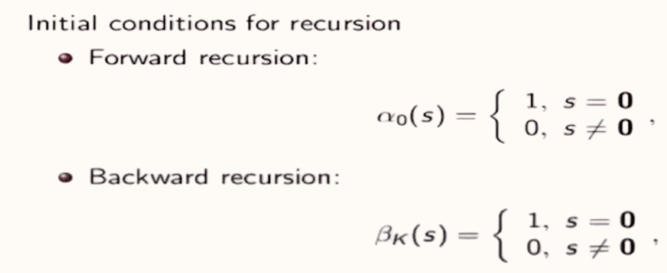

Slide 23
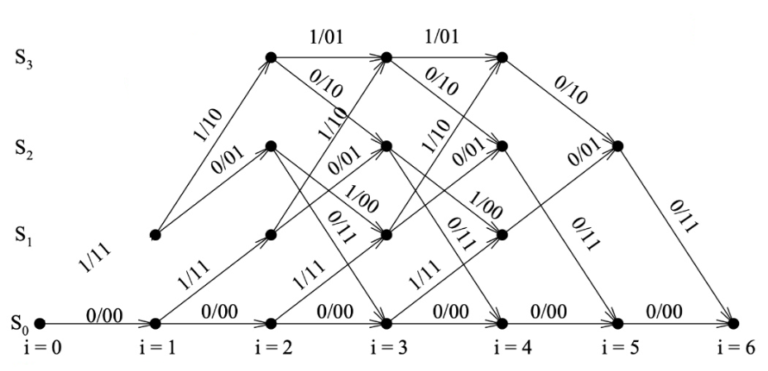
Trellis Diagram
Eg. m = [1 , 0 , 1 , 0 , 0, 0]

Slide 24
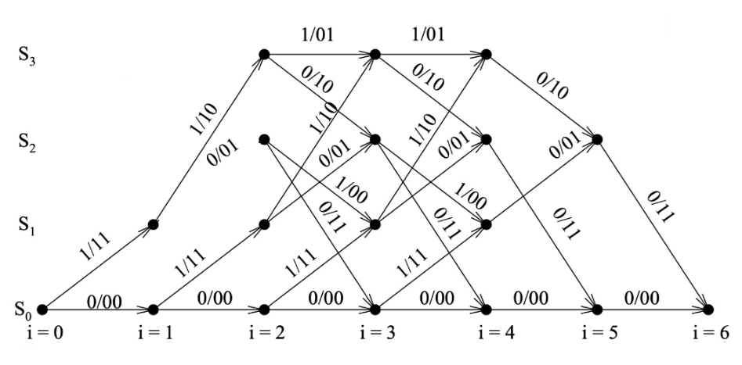

Slide 25
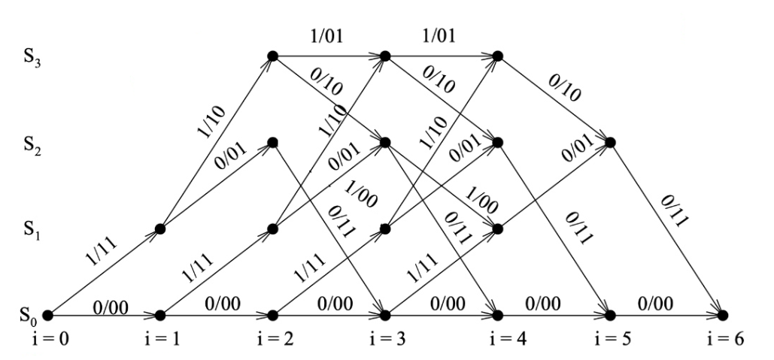

Slide 26
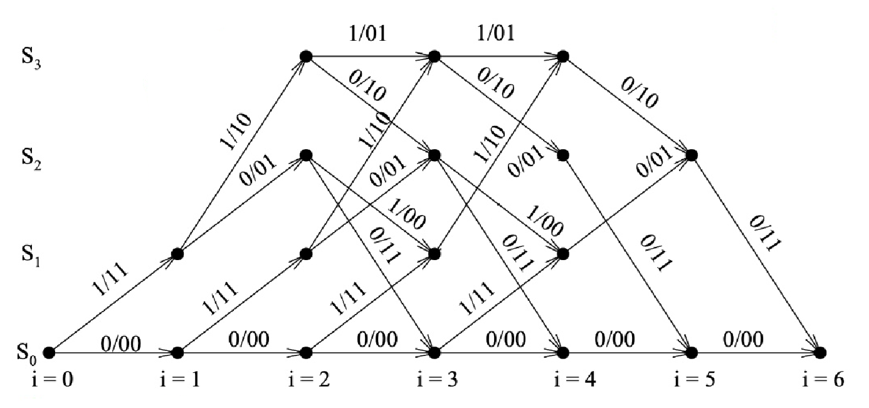

Slide 27
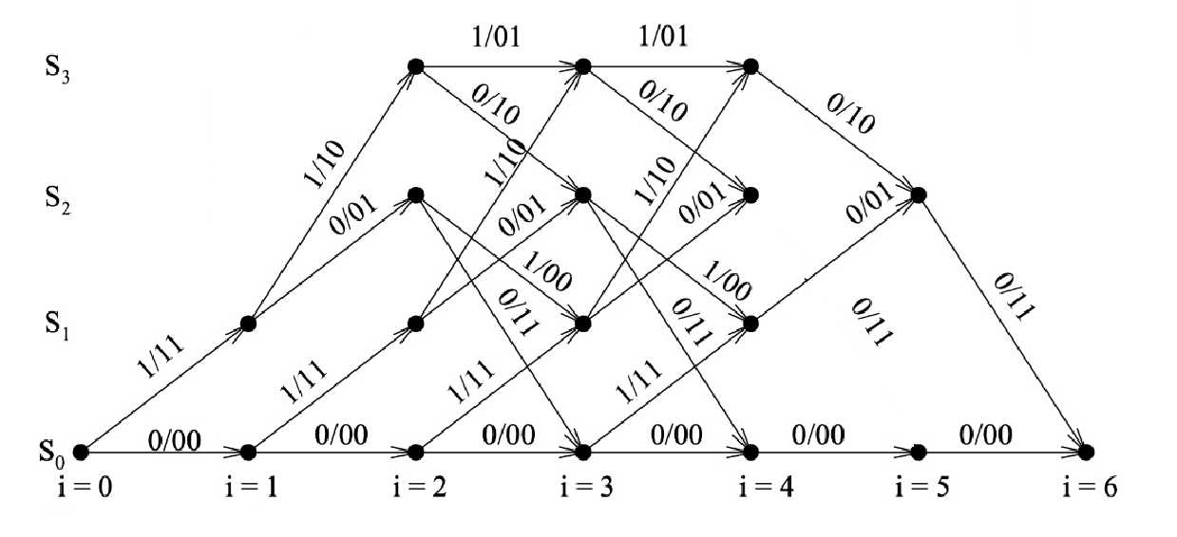

Slide 28
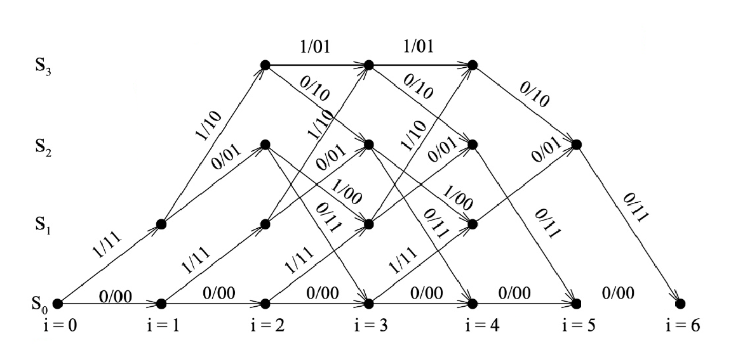

Slide 29
Codes:

Slide 30
Encoding:
function codeword = convolutionalEncoding(msg, generators)
[numRows,numCols] = size(generators);
mid_codeword = zeros(numRows,numCols+length(msg)-1);
for row = 1 : numRows
g = generators(row,:);
mid_codeword(row,:) = mod(conv(msg,g),2);
end
codeword = mid_codeword(:).';
end

Slide 31
State Diagram:
function stateTable = generateStateTable(K, generators)
numStates = 2^(K-1);
stateTable = zeros(numStates, 4);
for state = 0:numStates-1
prevBits = bitget(state, K-1:-1:1);
for inp = 0:1
reg = [inp prevBits]; outVec = mod(generators * reg', 2);
out = bi2de(outVec', 'left-msb');
nextBits = reg(1:end-1); nextState = bi2de(nextBits, 'left-msb');
col = inp*2 + 1;
stateTable(state+1, col) = out;
stateTable(state+1, col+1) = nextState;
end
end
end

Slide 32
Decoding ( Hard ):
function decoded = viterbiDecode_hard(s, n , received)
numStates = size(s,1);
N = size(received,1);
pathMetric = inf(numStates, N+1);
prevState = zeros(numStates, N+1);
prevInput = zeros(numStates, N+1);
pathMetric(1,1) = 0;
for t = 1:N
r = received(t,:);
for st = 1:numStates
if isfinite(pathMetric(st,t))
for inp = 0:1
col = inp*2 + 1;
outBits = de2bi(s(st,col), n, 'left-msb');

Slide 33
ns = s(st, col+1) + 1;
hd = sum(xor(outBits, r));
metric = pathMetric(st,t) + hd;
if metric < pathMetric(ns, t+1)
pathMetric(ns, t+1) = metric;
prevState(ns, t+1) = st;
prevInput(ns, t+1) = inp;
end
end
end
end
end
cur = 1;
decRev = zeros(1,N);
for t = N+1:-1:2
decRev(t-1) = prevInput(cur, t);
cur = prevState(cur, t);
end
decoded = decRev;
end

Slide 34
Decoding ( Soft ):
function decoded = viterbiDecode_soft(s, n, received)
numStates = size(s,1);
N = size(received,1);
pathMetric = inf(numStates, N+1);
prevState = zeros(numStates, N+1);
prevInput = zeros(numStates, N+1);
pathMetric(1,1) = 0;
for t = 1:N
r = received(t,:);
for st = 1:numStates
if isfinite(pathMetric(st,t))
for inp = 0:1
col = inp*2 + 1;
outBits = de2bi(s(st,col), n, 'left-msb');

Slide 35
ns = s(st, col+1) + 1;
bpskOut = 1 - 2*outBits;
ed = sum((bpskOut - r).^2);
metric = pathMetric(st,t) + ed;
if metric < pathMetric(ns, t+1)
pathMetric(ns, t+1) = metric;
prevState(ns, t+1) = st;
prevInput(ns, t+1) = inp;
end
end
end
end
end
cur = 1;
decRev = zeros(1,N);
for t = N+1:-1:2
decRev(t-1) = prevInput(cur, t);
cur = prevState(cur, t);
end
decoded = decRev;
end

Slide 36
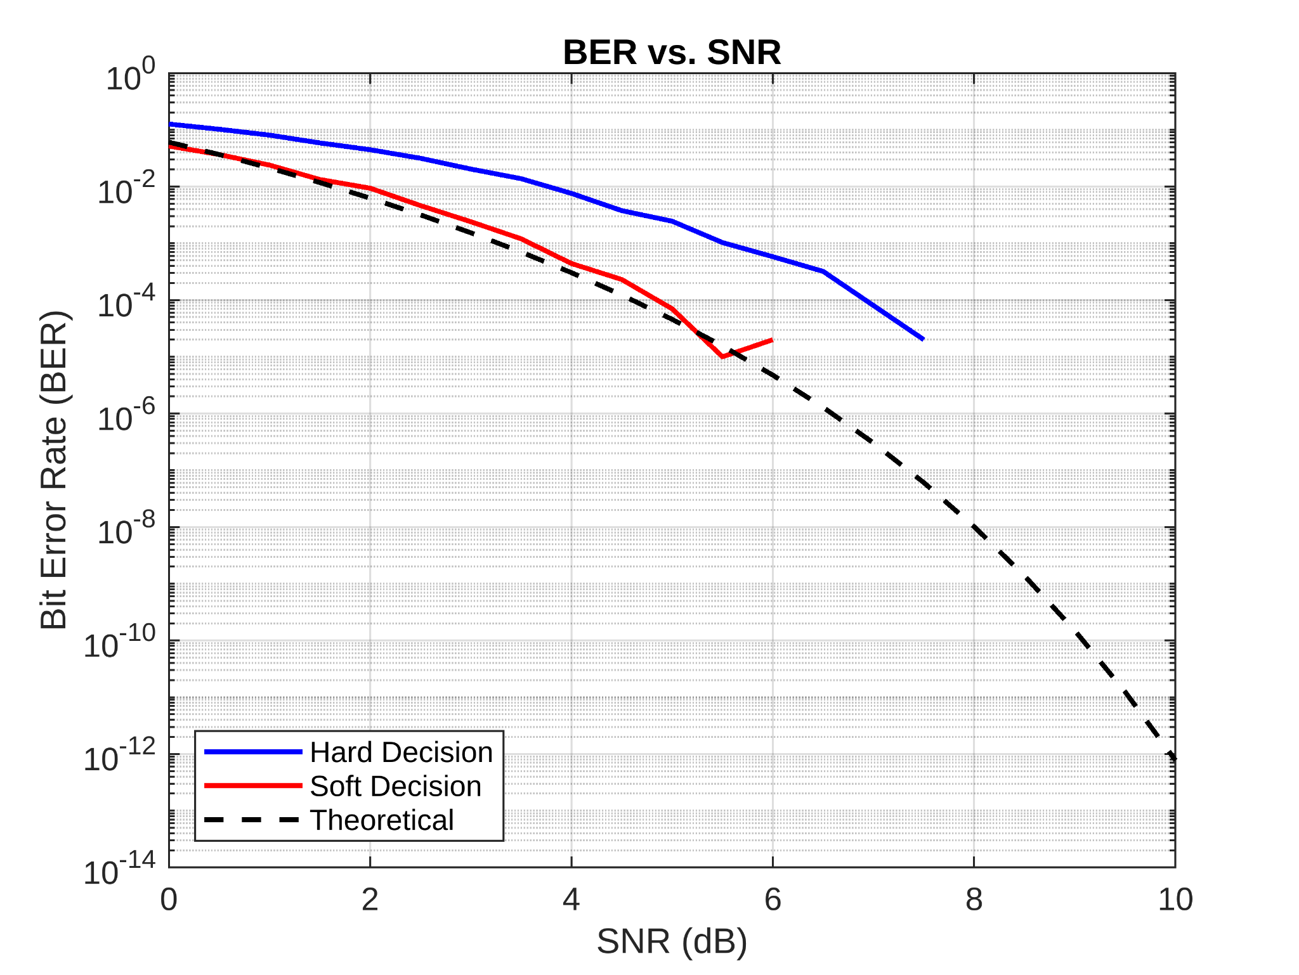
Simulation result: r=1/2, K=3

Slide 37
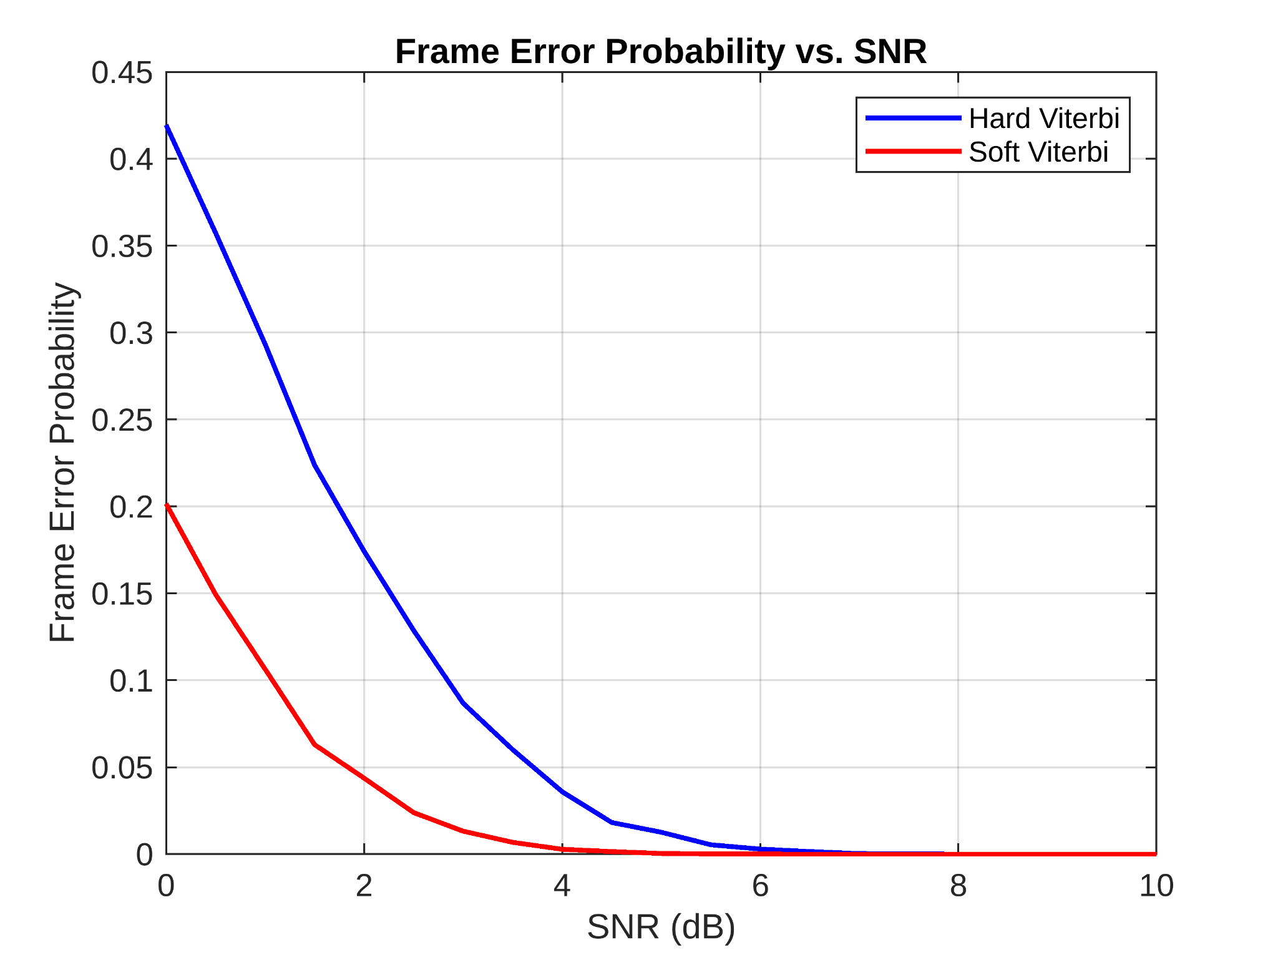
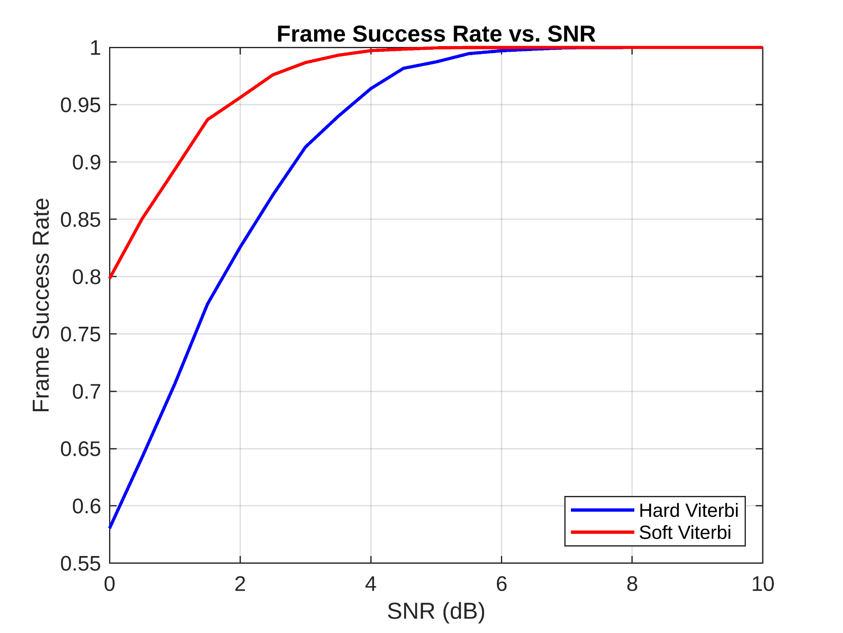
Simulation result: r=1/2, K=3

Slide 38
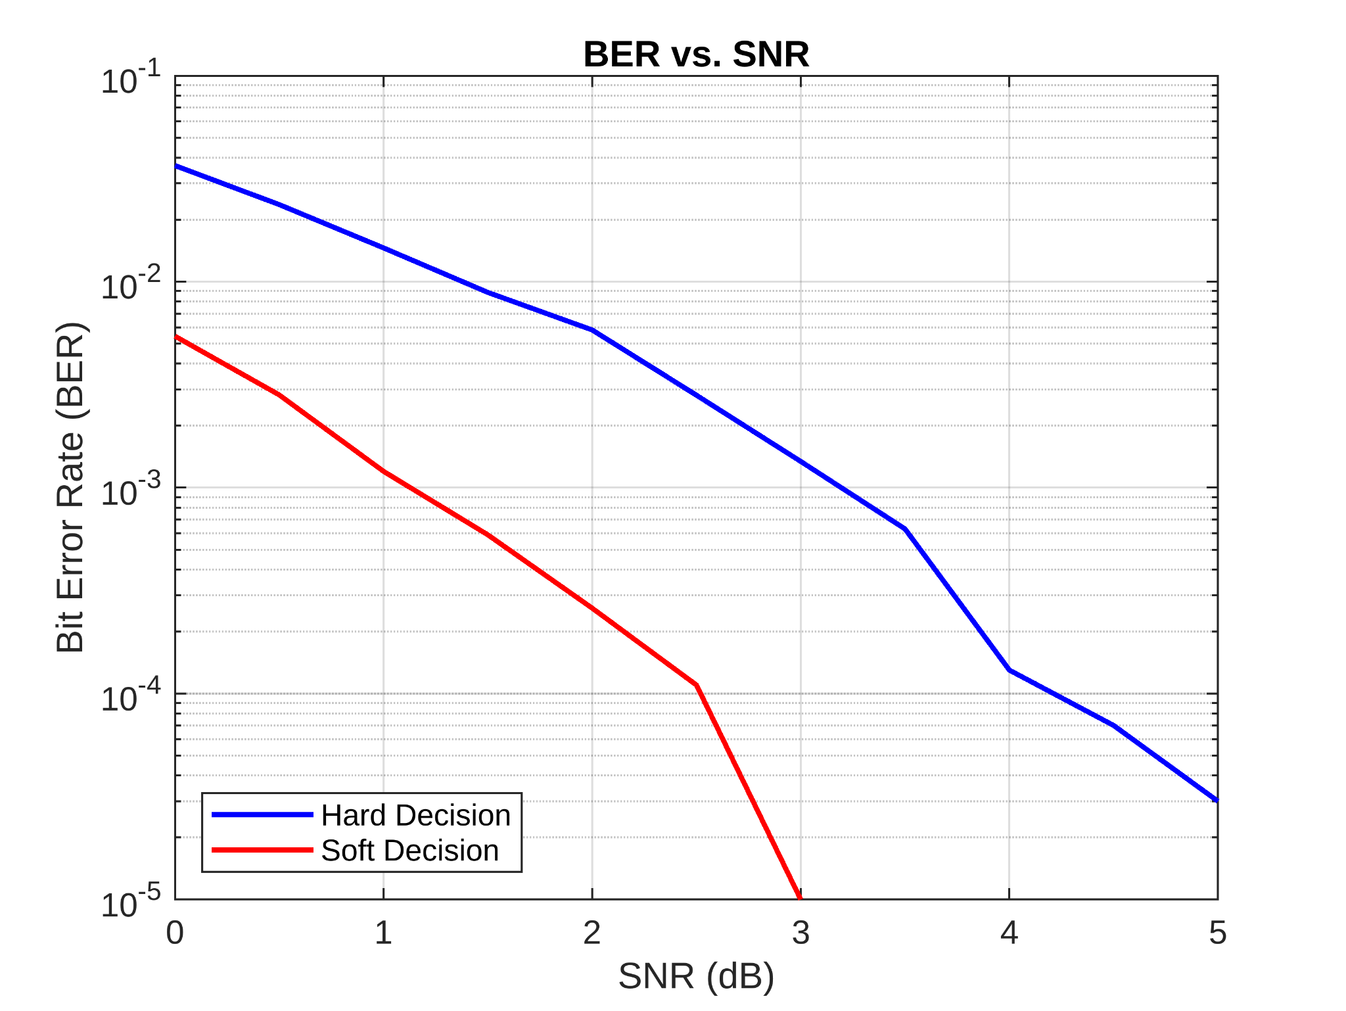
Simulation result: r=1/3, K=4

Slide 39
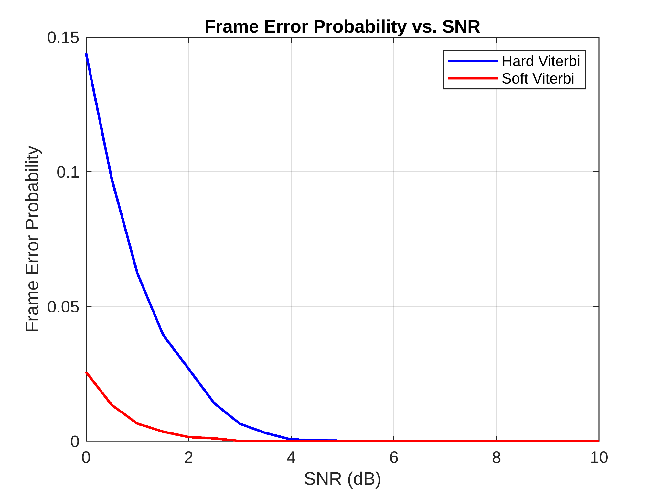
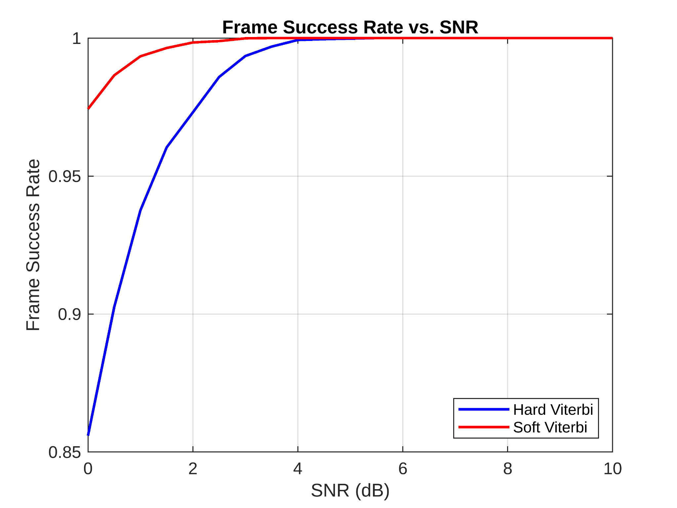
Simulation result: r=1/3, K=4

Slide 40
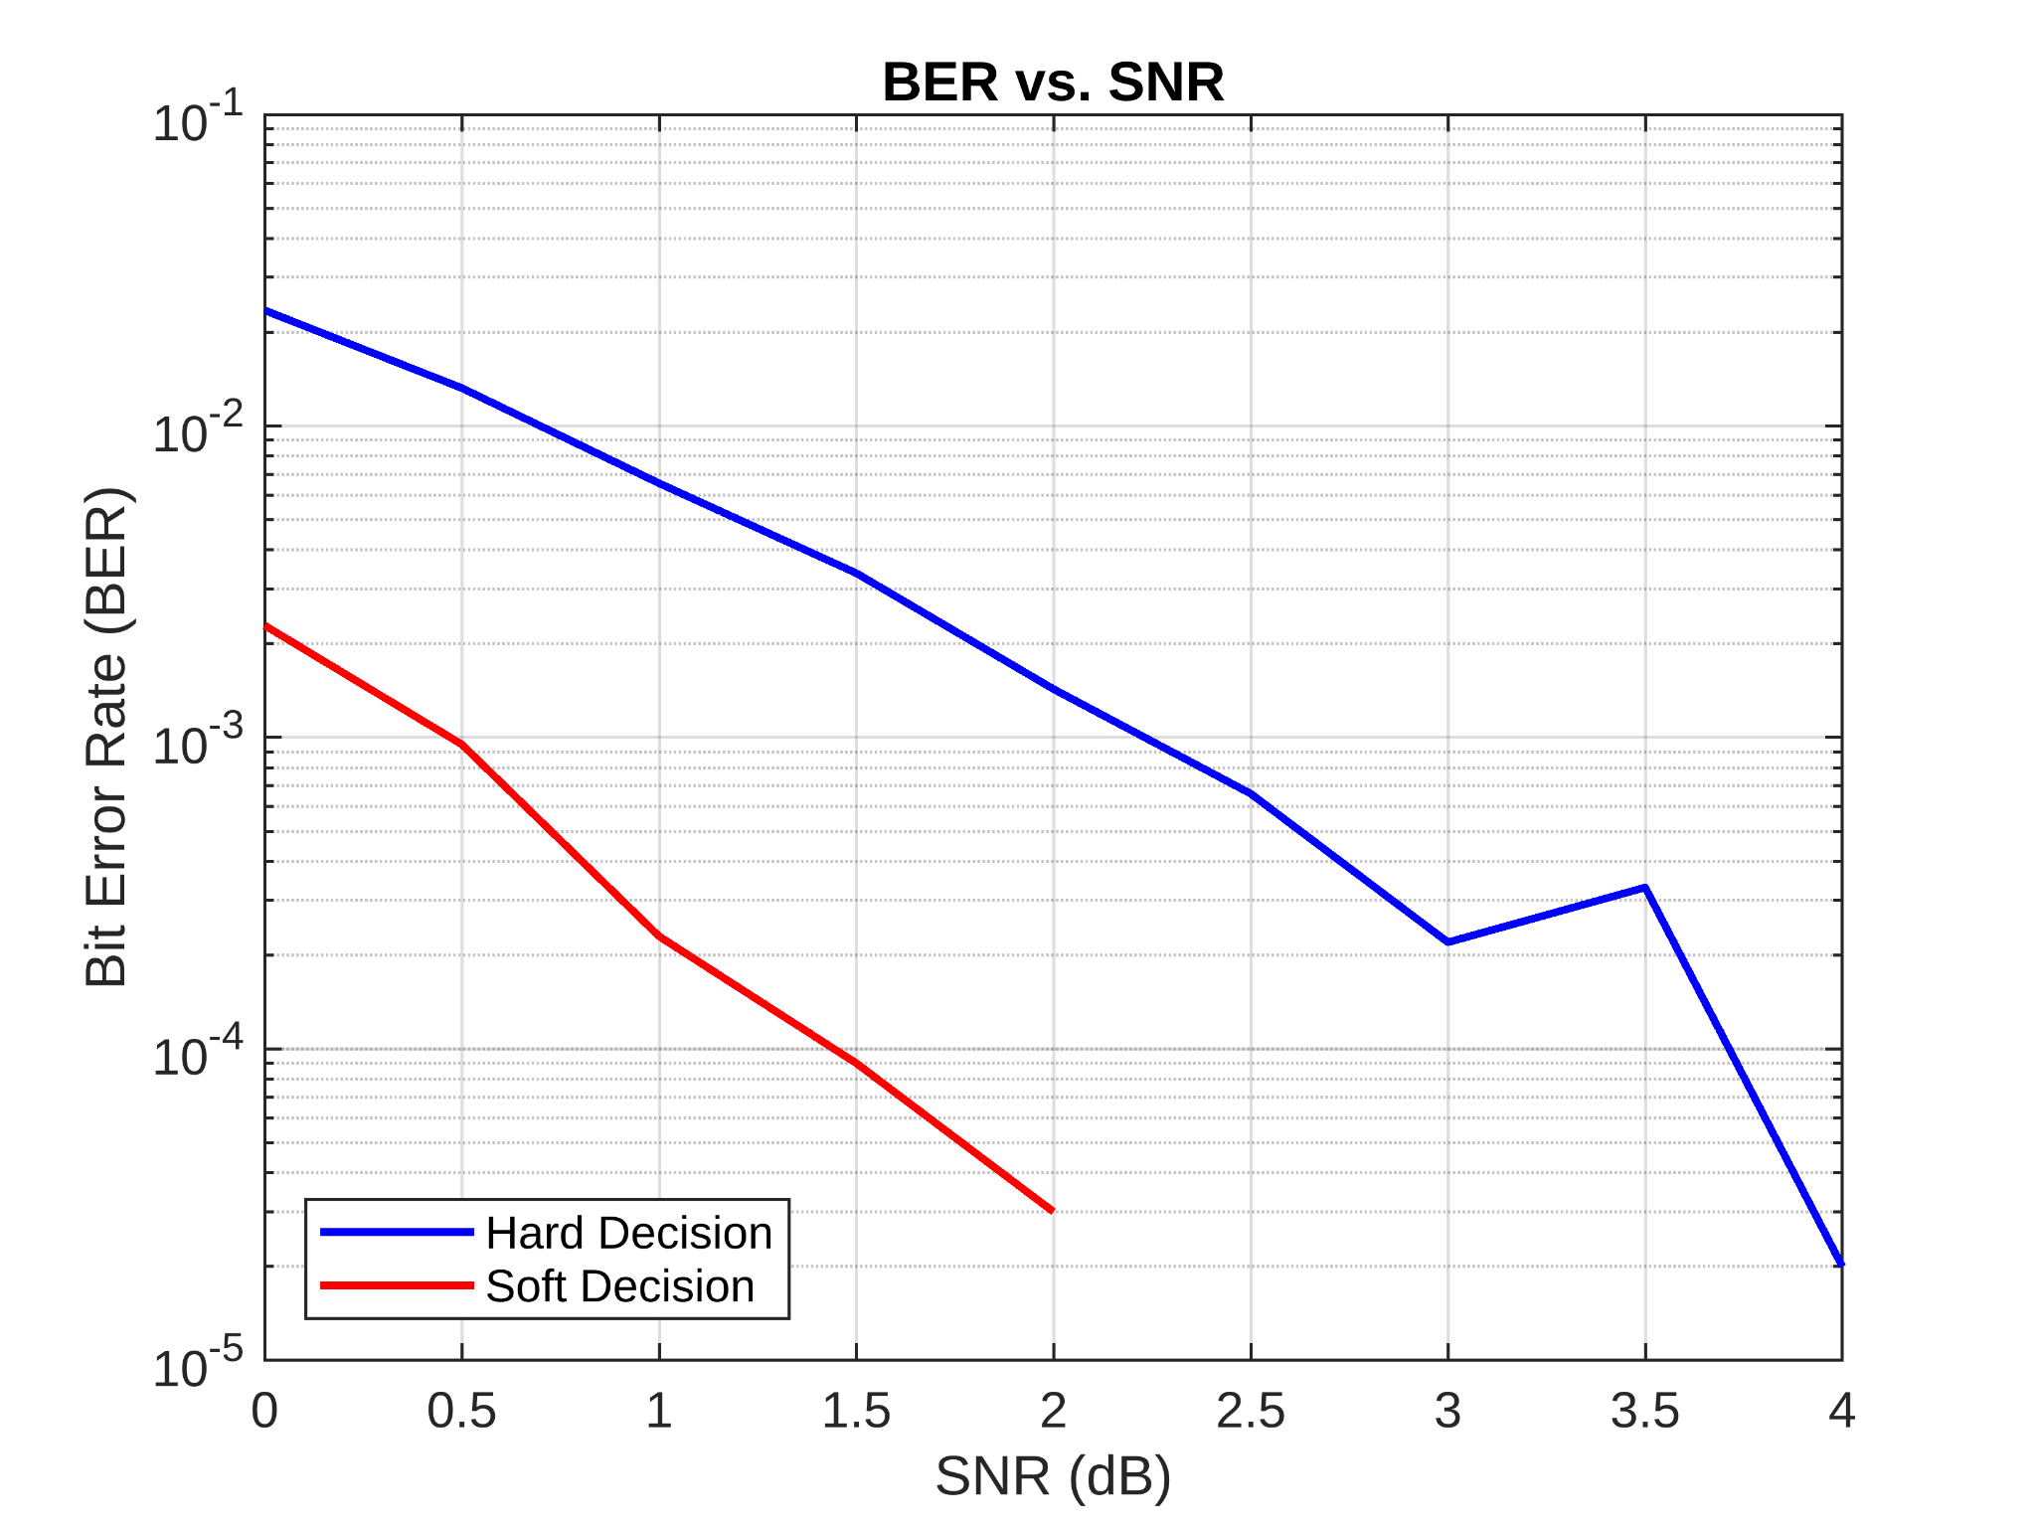
Simulation result: r=1/3, K=6

Slide 41
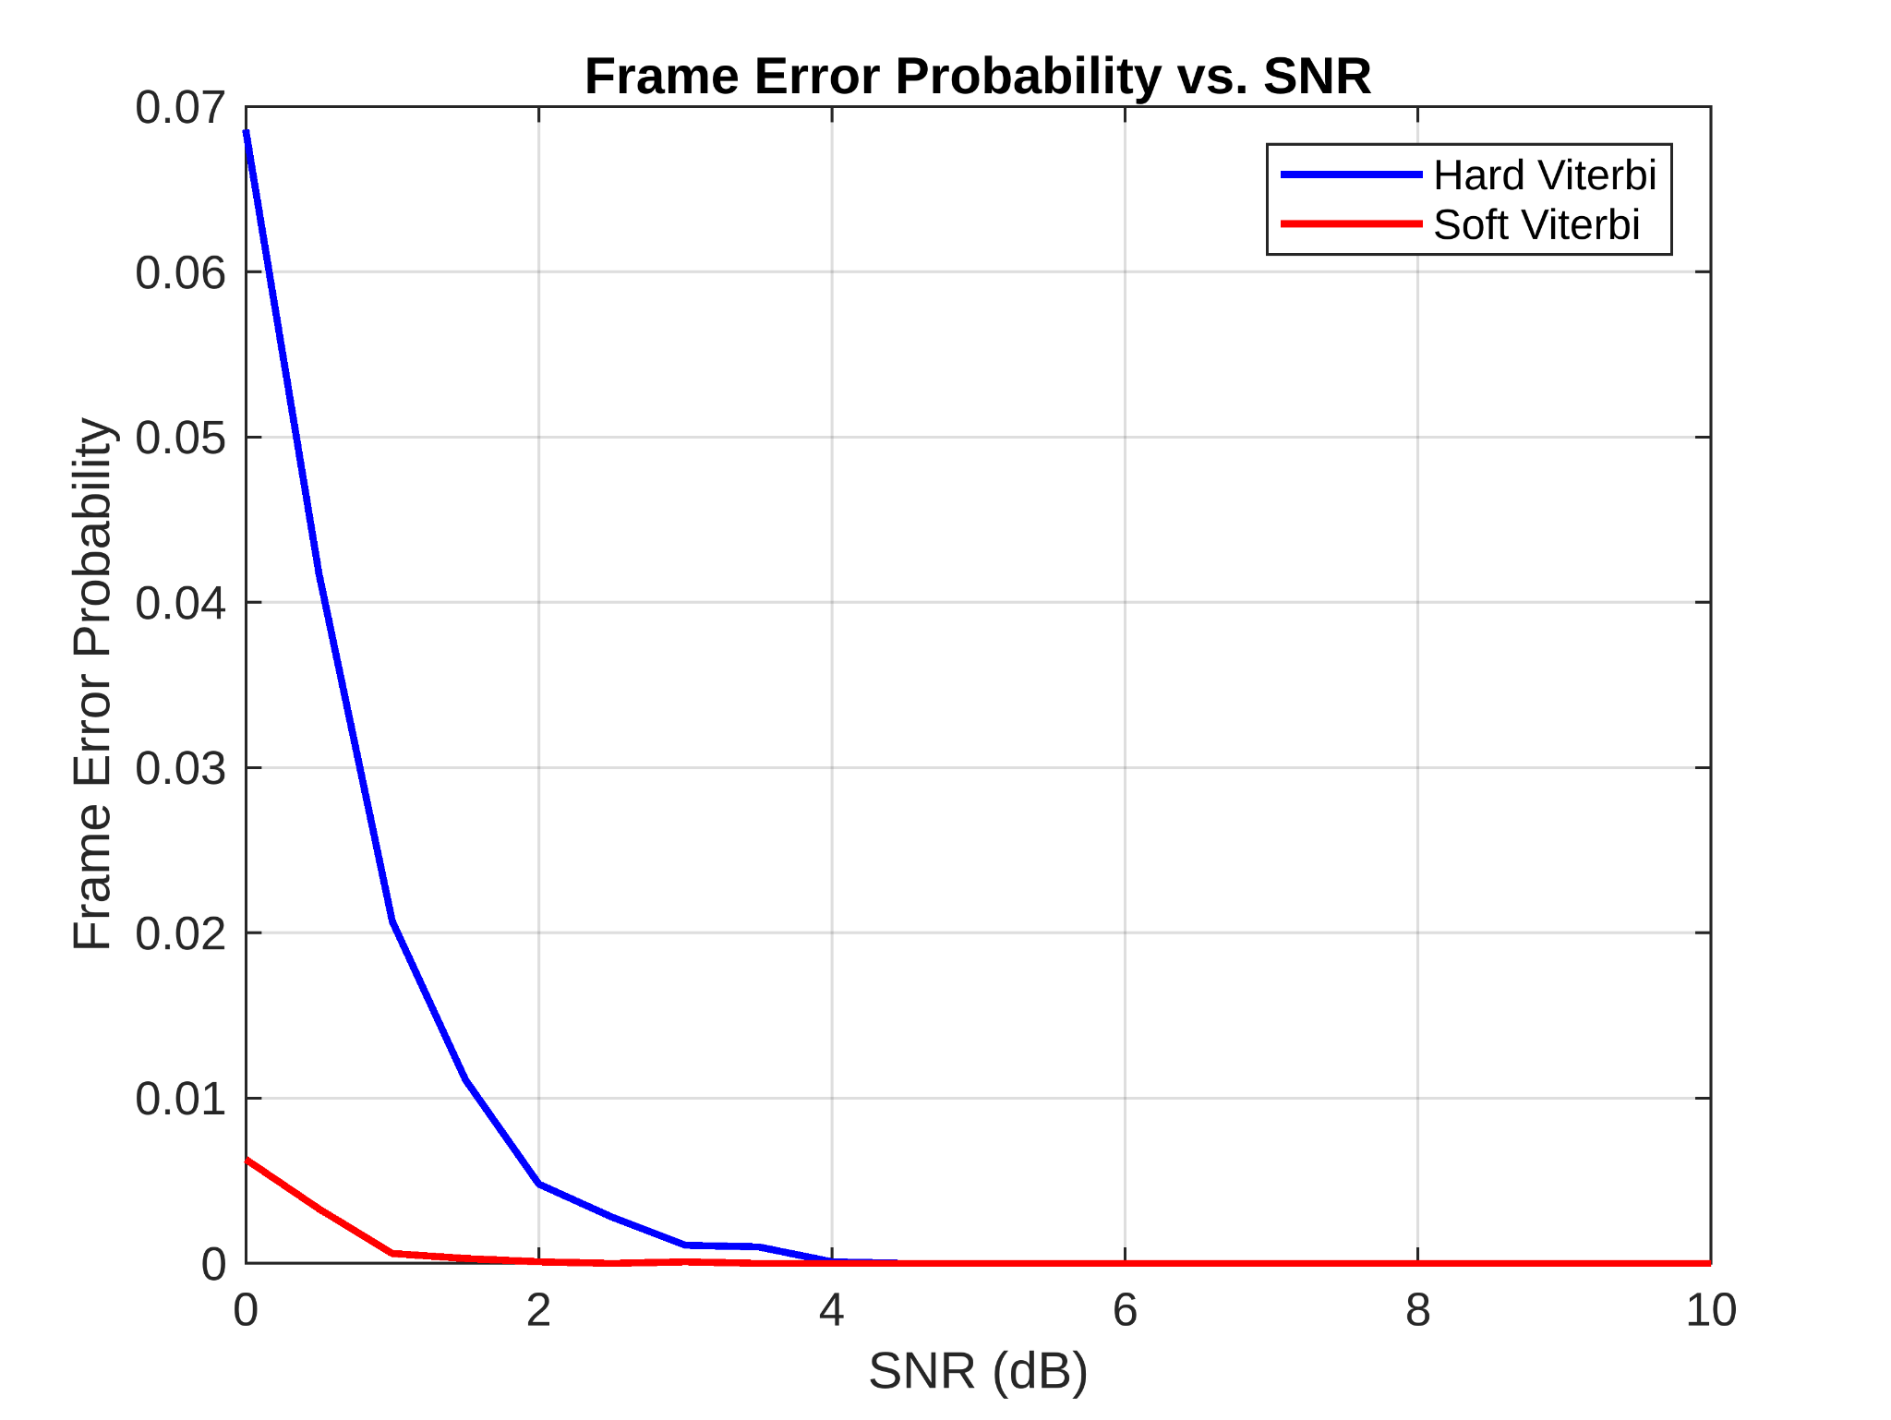
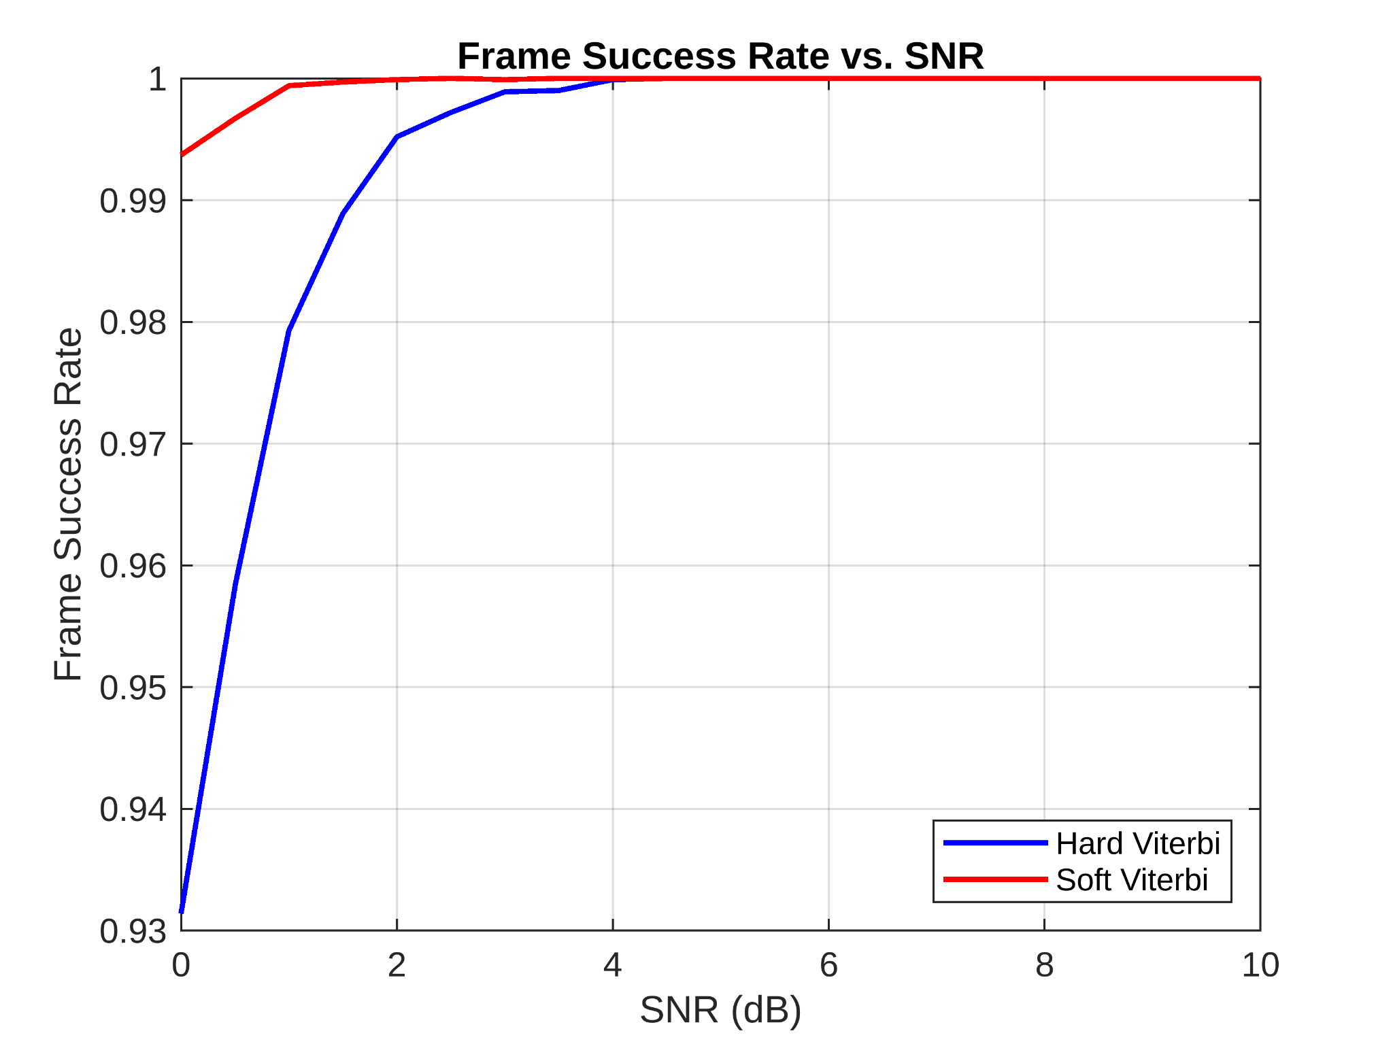
Simulation result: r=1/3, K=6

Slide 42
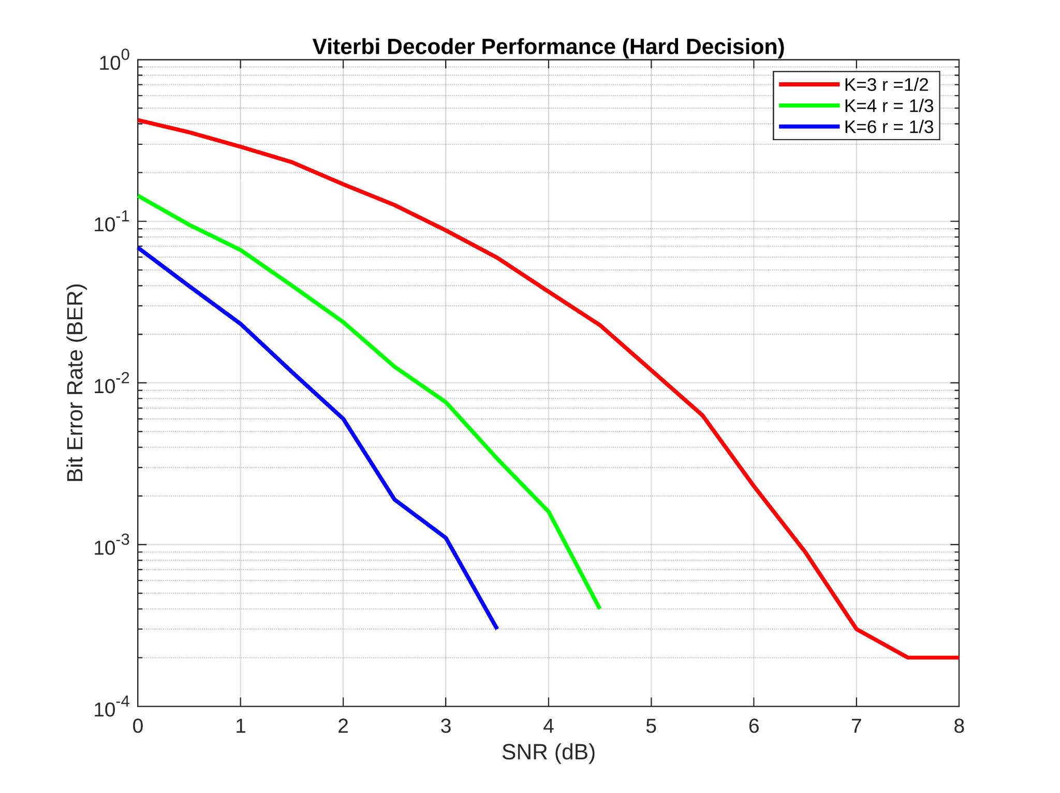
Comparing Hard Decision Decoding of all 3 Cases

Slide 43
Hard v/s Soft Viterbi Decoding
Hard Decoding :
Branch metric and Path metric is based on Hamming Distance
Simpler,Faster and less computationally demanding also requires less memory and simpler hardware
Soft Decoding :
Branch Metric and Path metric is based on Euclidean Distance
Much better error correction and uses confidence levels but is more complex
Conclusion : Soft decision decoding performs better because it uses more of the original analog information, giving the decoder a better shot at recovering the correct data — especially in noisy environments.

Slide 44
“Good communication is as stimulating as black coffee and just as hard to sleep after.”
—Anne Morrow Lindbergh

Slide 45
Group Members
Abhishek Guna
Dev Trivedi
Heet Bhuva
Jaimin Hadvani
Harsh Chanchlani
Rushabh Jain
Ayush Mittal
Tatva Shah
Heet Shah
Jeinil Patel
Dev Makwana

Slide 46
References:
CT216. Introduction to Communication Systems: Lecture 3 Channel Coding. DA-IICT, Winter, 2024.
Lecture by Prof. Adrish Banerjee, Dept. Electrical Engineering IIT Kanpur
J. G. Proakis. Digital Communications. McGraw-Hill, 4th edition, 1995.
Matthew Valenti and Bibin Baby John. Introduction to Communication Systems: A Lecture on Convolution Coding and Viterbi Decoding. DA-IICT, Winter 2024.
A Comparison Between LDPC Block and Convolutional Codes.

Slide 47
Thank
You!

